Slide 1
When will Leaders of Developing Countries Negotiate South-North Preferential Trade Agreements?
Lucie Lu Department of Political Science
University of Illinois at Urbana-Champaign
Notes:
Hi

Slide 2
Outline of Today’s Presentation
Introduction and Research Question
Context and Rationale
Theory: The Logic of Economic Reforms
Research Design
Empirical Findings
Tentative Conclusions
Questions and Comments

Slide 3
Introduction
Case of South Africa in 1994: PTA with the EU helped with the economic transition in South Africa
South Africa’s experience is a successful case:
Economic reforms usually provoke controversy and organized opposition domestically, so often the ability of leaders to implement such liberal economic reforms is limited.
PTAs provide member governments with a mandate to make policy changes, while they supply material benefits and mechanisms to reward and punish members’ behaviours.

Slide 4
Research question
Recognizing the preferential trade agreement with provisions of economic reforms is a binding commitment that imposes policy reforms and entails political costs, some leaders in the developing countries chose to negotiate it with the major liberal trade powers, while some did not.
Why and when will leaders in the developing countries negotiate South-North preferential trade agreements with provisions of economic reforms?

Slide 5
Research question
Why focusing on South-North PTAs, in particular?
Rapidly growing international institution that help states to foster trade and economic integration among member-states.
South-North PTAs with the provision of economic reforms are one of the most costly and deepest agreements by design.
Why does it matter?
PTA negotiation reflects deliberate choices of leaders.
Explain what motivates a leader to negotiate this particular deep and demanding international treaty and conduct economic reforms.

Slide 6
Context and Rationale
Effects versus causes:
Current literature on the preferential trade agreement mainly focuses on the effects of this institution: whether they have achieved their economic purposes.
In contrast, this paper contributes to the causes of states’ formation of the PTAs.
What are the gaps in the literature?
Overlook the design differences of the PTAs: the provision of economic reform comes in.
Overlook a key actor: How about opposition?

Slide 7
Context and Rationale
Recent studies zoom into the domestic factors within the states to explain this trend.
Regime types matter: Democratic countries are more likely to join a PTA than nondemocratic countries (Mansfield & Milner, 2012; Mansfield, Milner, & Rosendorff, 2002).
Interest groups matter: Grossman and Helpman (1995)
Private sectors matter: (Staiger & Tabellini, 1999).
Opposition matters:
A leader negotiates a PTA with the provision of economic reform to punish the opponents’ past transgression.

Slide 8
Context and Rationale
Highlights:
leaders negotiate PTAs for political reason.
PTA negotiation is a deliberate choice that a leader makes to commit to the binding and stringent policy reforms to rearrange the domestic power structures.

Slide 9
Theory: The Logic of Economic Reforms

Slide 10
Research Design
Hypothesis:
The presence of shocks to security in a regime is associated with higher probabilities of its leader's PTA negotiation.
(Hypothesized Treatment)
Shock to Leader’s Security
+
South-North PTA Negotiation
Research Design:
Compares the likelihoods of leaders with shocks to security (hypothetical treated group) and without (hypothetical control group) to negotiate the South-North PTAs.

Slide 11
Research Design
Quasi-experiment:
Hypothetical Treatment: Shock to Leaders’ Security
Two indices to measure the security of a leader:
1) A leader's security when he starts his tenure at time 0 depending on his relation to the past leader (or not); and,
2) The security of the regime when the leader holds office at time t.
Two Types of shocks to security:
1) Type 1: a leader is secure at time 0 and becomes insecure immediately onward at time 1 (experiences a shock to security at time 1).
2) Type 2: a leader experiences a shock to security during his tenure a time t.

Slide 12
Examples in Datasets
Unit of analysis: Leader-Year
Coun-try | Ye-ar | Lea-der | Reg-ime | R.T. Past | P. Eff | PTA nego
Albania | 1995 | Berisha | Dem. | NA | 1 | 0
Albania | 1996 | Berisha | Dem. | NA | 1 | 0
Albania | 1997 | Berisha | Dem. | NA | 1 | 0
Albania | 1997 | Fatas | Dem. | NA | 1 | 0
Albania | 1998 | Fatas | Dem. | NA | 2 | 0
Albania | 1999 | Meta | Dem. | NA | 2 | 0
Albania | 2000 | Meta | Dem. | NA | 2 | 0
Albania | 2001 | Meta | Dem. | NA | 2 | 0
Albania | 2002 | Meta | Dem. | NA | 2 | 1
 |  |  | . . .
Algeria | 1995 | Zeroual | Dict. | Regime | 2 | 0
Algeria | 1996 | Zeroual | Dict. | Regime | 2 | 1
Algeria | 1997 | Zeroual | Dict. | Regime | 2 | 0
Algeria | 1998 | Zeroual | Dict. | Regime | 2 | 0
Algeria | 1999 | Zeroual | Dict. | Regime | 2 | 0
Egypt | 2013 | Mansour | Dict. | Opposit-ion | 2 | 0
Egypt | 2014 | Mansour | Dict. | Opposit-ion | 2 | 0
Nambia | 2005 | Pohamb | Dict. | Opposit-ion | 0 | 0
Nambia | . . . | Pohamb | Dict. | Opposit-ion | . . . | . . .
Nambia | 2015 | Pohamb | Dict. | Opposit-ion | 0 | 0
Unit of analysis: Leader
(Main dataset)
e
Cou-ntry | Leader | Te-nure | Reg-ime | R.T. Past | P. Eff | Shock (Z) | PTA nego
Albania | Berisha | 3 | Dem. | NA | ins_all | 0 | 0
Albania | Fatas | 2 | Dem. | NA | shock_t | 1 | 0
Albania | Meta | 4 | Dem. | NA | shock_t1 | 1 | 1
 |  |  | . . .
Algeria | Zeroual | 6 | Dict. | Regime | shock_t1 | 1 | 1
Egypt | Mansour | 2 | Dict. | Opposi-tion | ins_all | 0 | 0
Nambia | Pohamb | 11 | Dict. | Opposi-tion | s_all | 0 | 0

Slide 13
Research Design
Coding Strategies and Justifications:
Unit of analysis is leader. The dataset covers 286 leaders in 62 developing countries in the period 1995 to 2015.
Dependent Variable: South-North PTA negotiation
Independent Variable: Shocks to Security
Matching on the Covariates: Regime Type, Human Rights Conditions, Regime Duration, GDP per capita
Confounding Variables in the OLS Model:
Leaders’ tenure
Economic Recession (Negative Economic Growth)

Slide 14
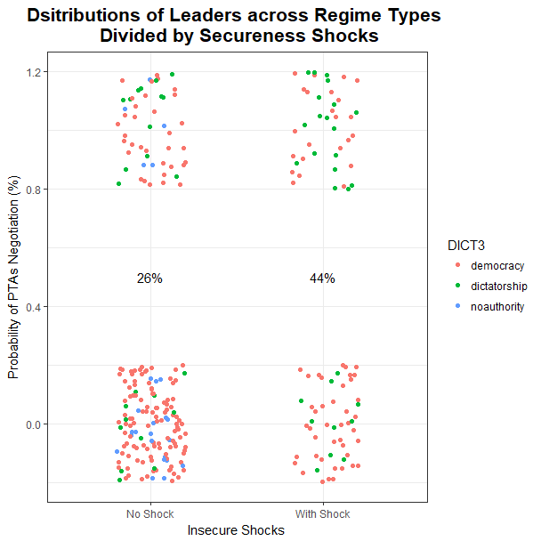
Empirical Findings: Data Description

Slide 15
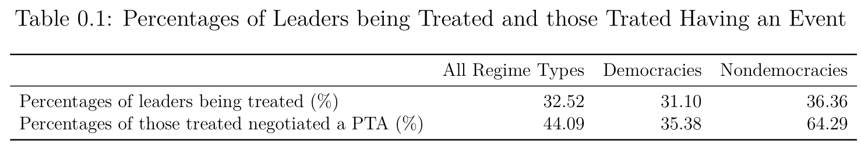
Empirical Findings: Data Description

Slide 16
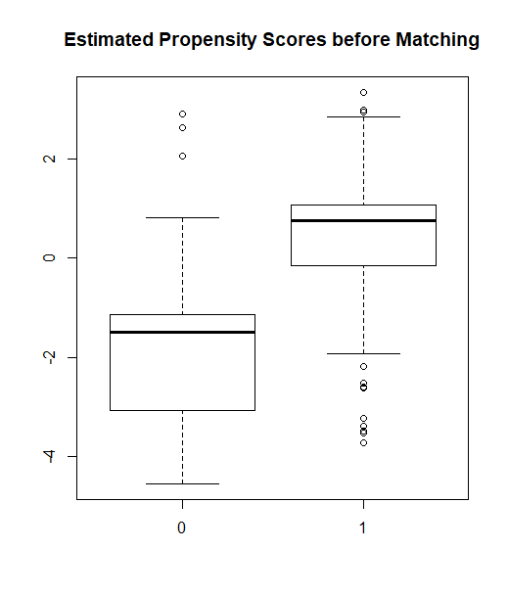
Empirical Findings: Propensity Score Before Matching
The estimated propensity scores are the fitted probabilities of being treated given four covariates.
The difference between two distributions are substantial.

Slide 17
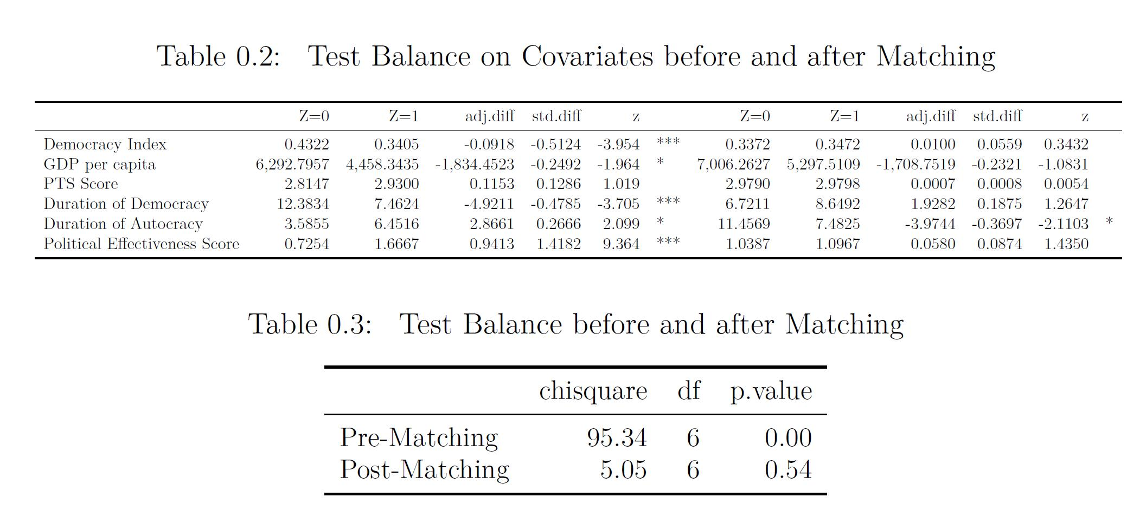
Empirical Findings: Propensity Score After Matching
After matching, leaders in the treatment and control groups are comparable.

Slide 18
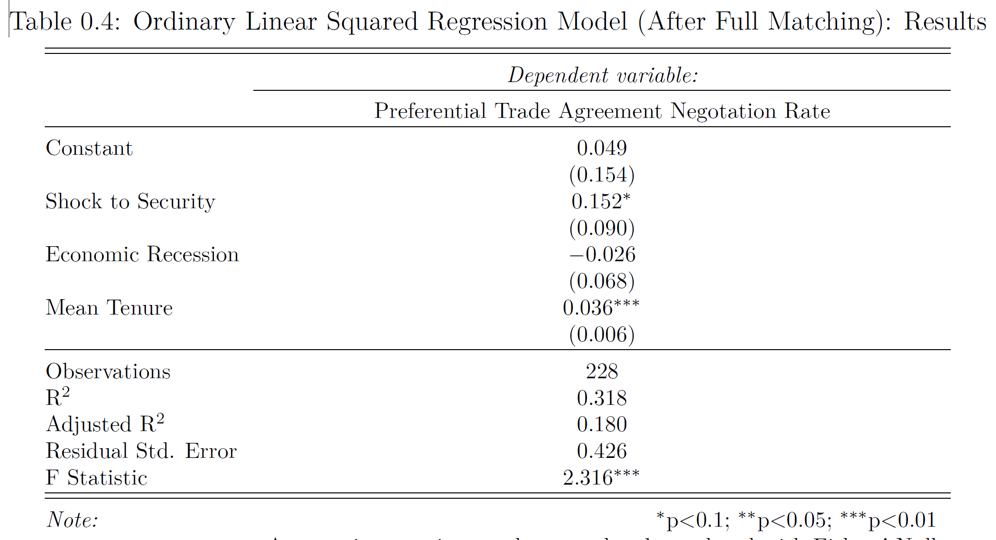
Empirical Findings: Treatment Effect After Matching

Slide 19
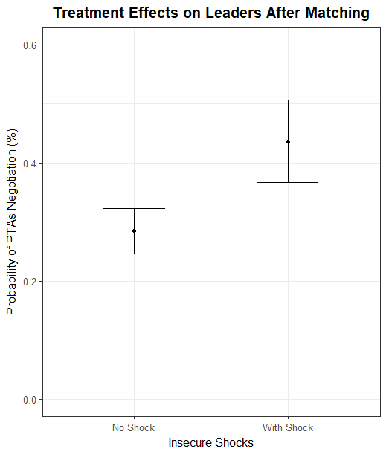
Empirical Findings: Treatment Effect After Matching
Holding leaders’ mean tenure constant, when there is no economic recession, those leaders who have experienced insecure shocks on average have around 15% higher probability to negotiate a PTA than those without such “treatment”.

Slide 20
Conclusion
My hypothesis is empirically supported:
When leaders experience political crisis, they are more likely to negotiate a South-North preferential trade agreement with the provision of economic reforms.
Recap:
Why and when will leaders in developing country negotiate South-North Preferential Trade Agreements? The answer is simple and intuitive: when leaders in developing country experience a shock that creates political instability, they are more likely to negotiate a preferential trade agreement with the provision of economic reform with the expectation to cut off the power sources of the disloyal opposition.
Notes:
hello

Slide 21
Moving forward:
Explore whether PTA negotiation helps leaders to conduct economic reforms.
Questions and Comments are Greatly Appreciated!

